Slide 1

Forecasting nba statistics
Using Machine Learning to find the optimal DraftKings Daily Fantasy Basketball Lineup

Slide 2
Presentation Overview
What is DraftKings NBA Daily Fantasy?
Collecting the data
DraftKings Score
Time Series Model
Finding the Optimal Lineup
Results ($$$)
Insights and Potential Improvements

Slide 3
What is DraftKings NBA Daily Fantasy?
Daily contest hosted on DraftKings.com.
Participants are given a list of NBA players that will be playing that night, and a salary attached to each of those players.
The goal of the contest is to choose 8 players that the participant thinks will have the highest "DraftKings score" while remaining under the $50,000 salary cap.
For example, LeBron James may cost $12,000 on a given night, while Joe Schmo may only cost $3,000.
Position restrictions
(Point Guard, Shooting Guard, Small Forward, Power Forward, Center), as well as 3 wildcards (a guard of any kind, a forward of any kind, and any position).

Slide 4
DraftKings Scoring
Point +1 pts
Made 3pt Shot +.5 pts
Rebound +1.25 pts
Assist +1.5 pts
Steal +2 pts
Block +2 pts
Turnover -.5 pts
Double-Double +1.5 pts
Triple Double +3 pts

Slide 5
Project Goal
Find DraftKings Lineup with highest total Score
Plug Players into the contest
Watch the money roll in!

Slide 6
Collecting the Data
1. Game-Logs for past 5 seasons.
2. NBA players that are playing that night.
3. DraftKings salaries/position for those players.

Slide 7
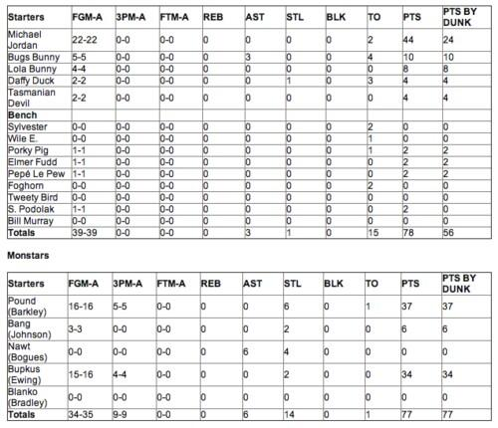

What is a Game Log?

Slide 8
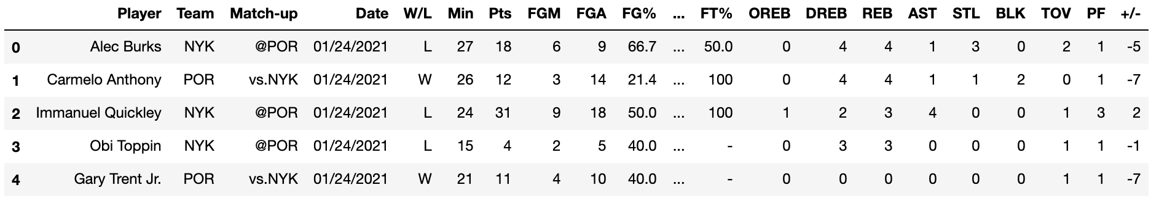
Data Collection
Web-Scraping with Selenium
Clicking “Accept Cookies”
Clicking the ”Next Page”
Beautiful Soup

Slide 9
VAR Time Series Model
Uses time series data to forecast the next game.
Data needs to be stationary (constant mean, variance, etc.)
Differenced data
Points, Rebounds, Assists, and DraftKings Score variables.

Slide 10
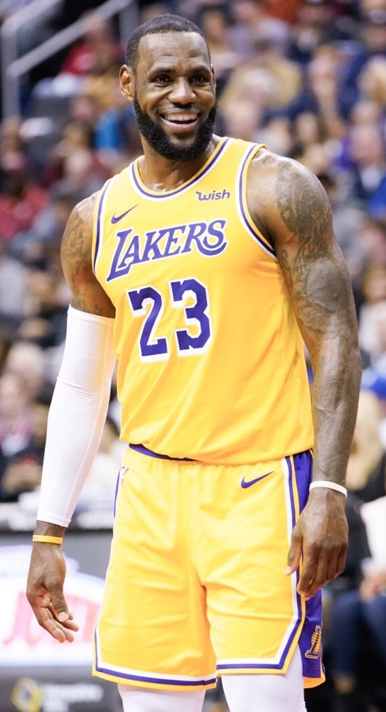
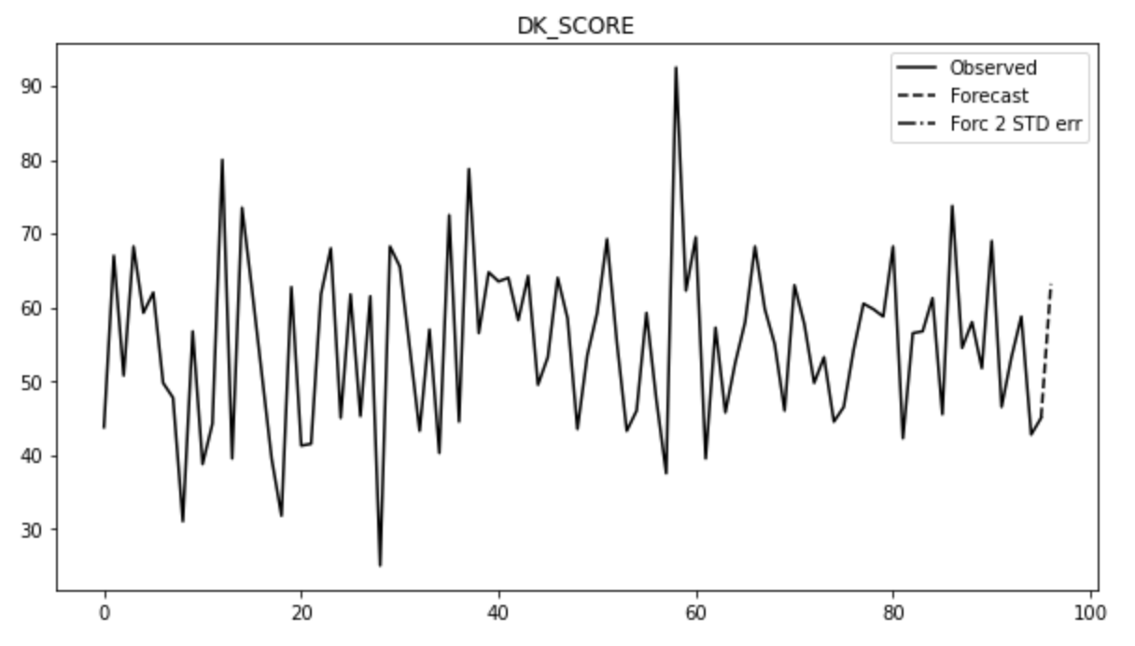
LeBron James
DraftKings Score Forecast

Slide 11
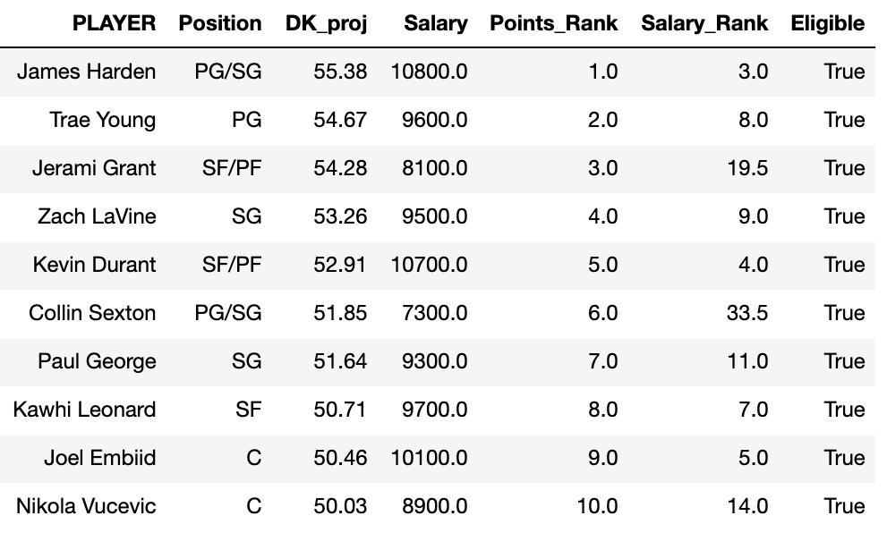
All Player Projections – Jan 23, 2020

Slide 12
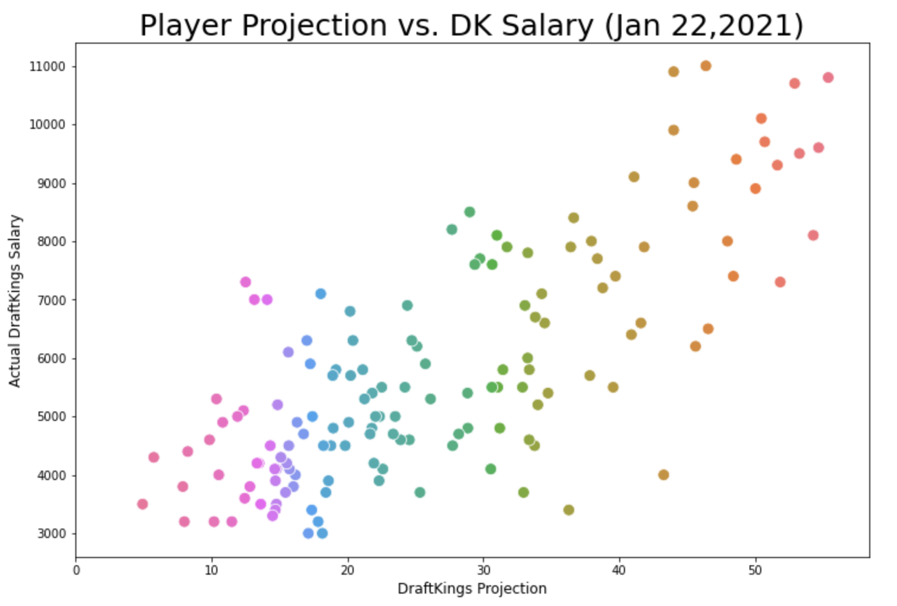

Slide 13
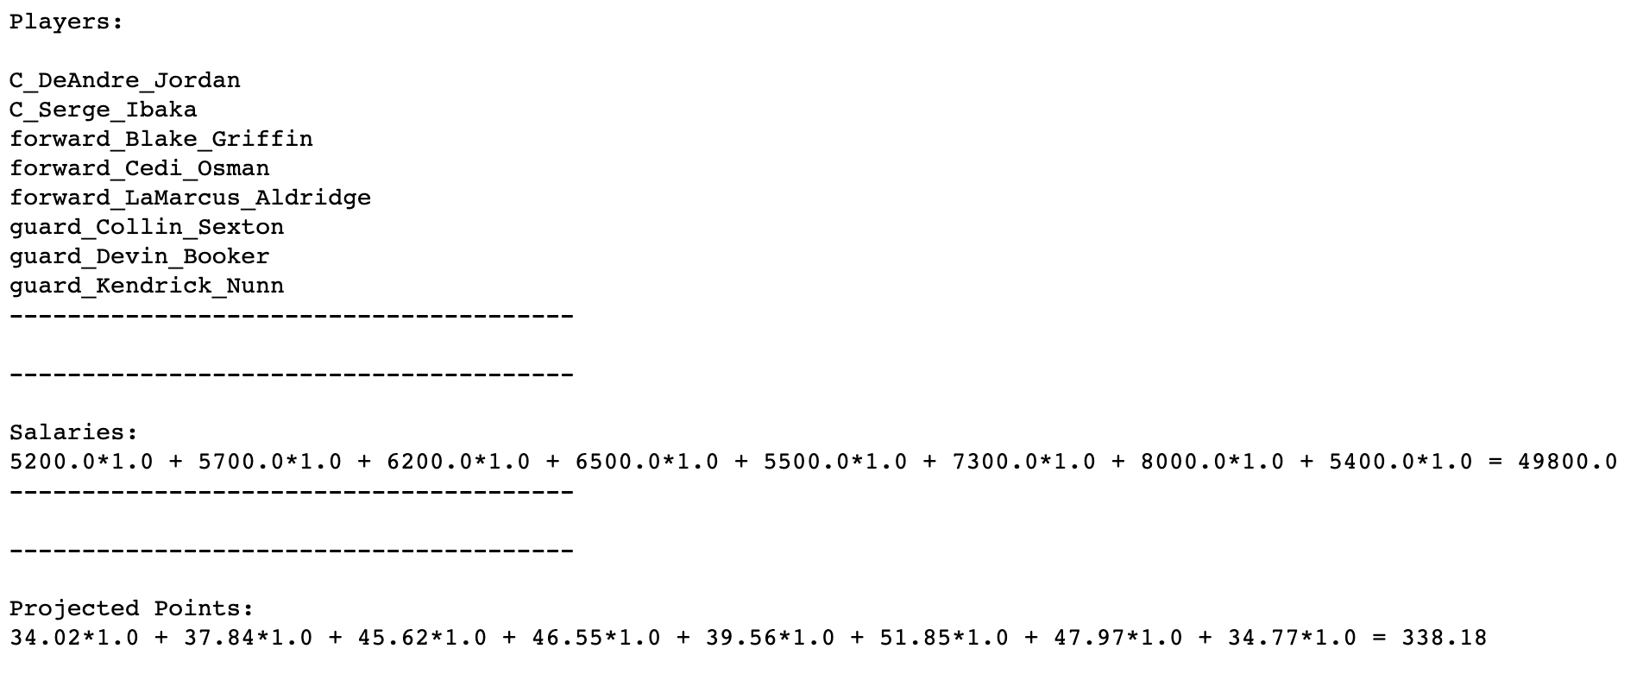
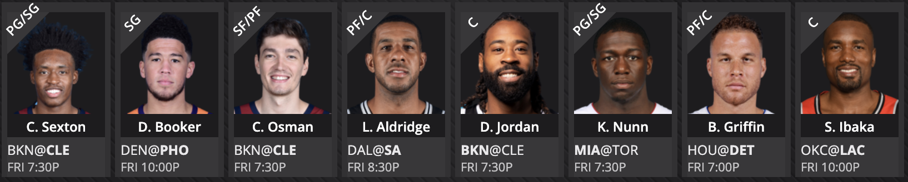
Optimizing the Lineup

Slide 14
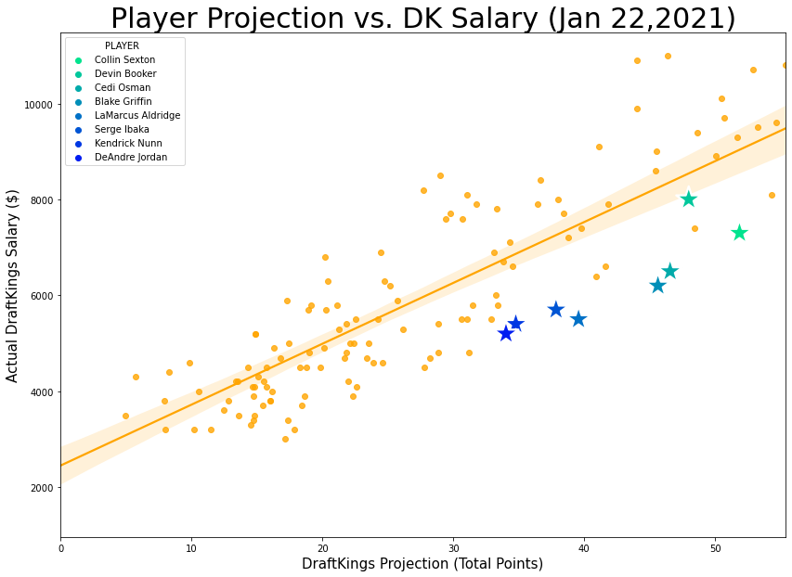

Slide 15

Entering the Competition
Net Winners in last 7 days: 16%
Average 45,083 players per competition
~22% win money each competition

Slide 16
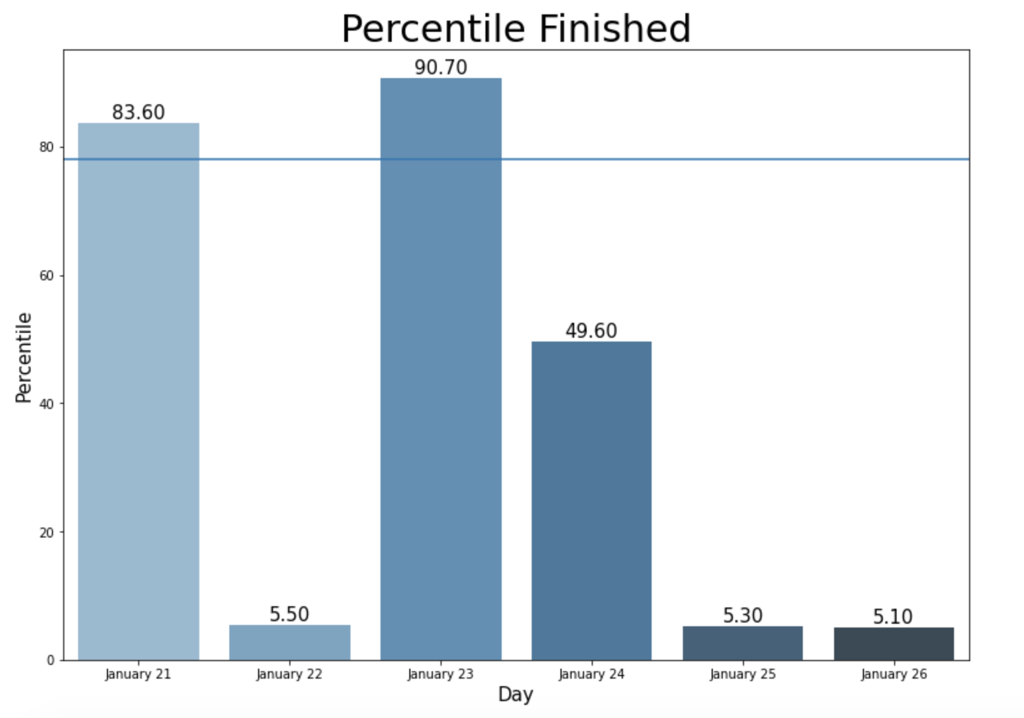
Money-Making Line
Money-Making Line

Slide 17
Potential Improvements
Add more features:
Match-ups defensive statistics.
Rest Day statistics.
James Harden Problem
Home/Away.

Slide 18
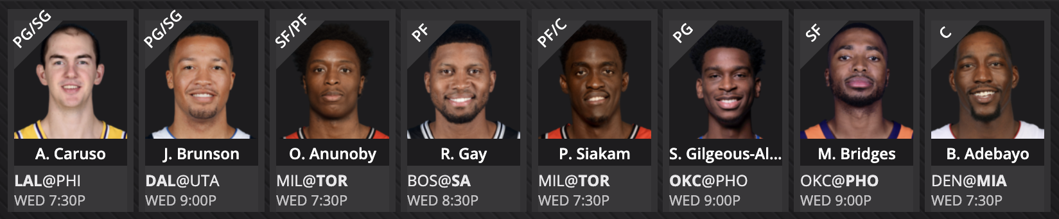
Tonight’s Lineup

Slide 19
Thanks for Listening!!
References
Nba.com
Sportsline.com
Fantasypros.com
Branko Blagojevic “Using Python and Linear Programming to Optimize Fantasy Football Picks”
Kevin Song “Scraping Stats.nba.com With Python”
Pictures: SpaceJam, Wikipedia

